Slide 1
MODULE 4: FUEL CELLS & ELECTRIC VEHICLE ARCHITECTURE TOPOLOGIES

Slide 2
Outline
Electric Motor Drive
Flowchart of EV
Losses in an EV
Examples
Reasons to go for an EV
How different EV work?
Your Choice
Fuel Cell Calculations
Clean Mobility
Electric Vehicles
History of Electric Vehicles
Choosing Right EVs
BEY
HEV
• Series HEV
• Parallel HEV
• Series-Parallel HEV
• Advantages and Challenges of HEV

Slide 3
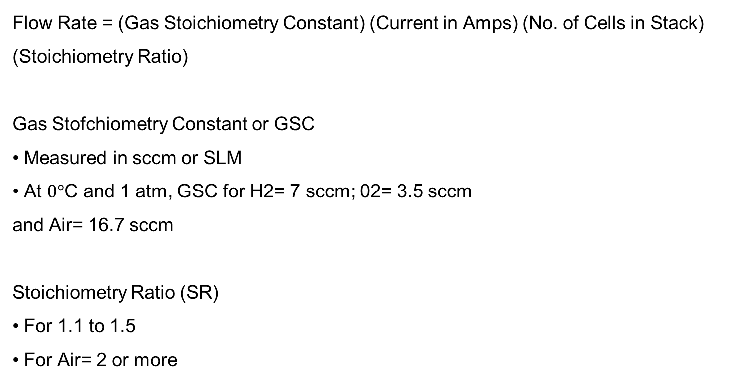
FUEL CELL CALCULATIONS
Flow Rate = (Gas Stoichiometry Constant) (Current in Amps) (No. of Cells in Stack) (Stoichiometry Ratio)
Gas Stofchiometry Constant or GSC
• Measured in sccm or SLM
• At $0°$C and 1 atm, GSC for H2= 7 sccm; 02= 3.5 sccm
and Air= 16.7 sccm
Stoichiometry Ratio (SR)
• For 1.1 to 1.5
• For Air= 2 or more

Slide 4
EXERCISE
A 25 cm2 single cell operating on H2 & Air will have a current density of 1 A/cm2. Find
a) Current
b) H2 Mass flow rate at S.R. 1
c) H2 Mass flow rate at S.R. 4

Slide 5
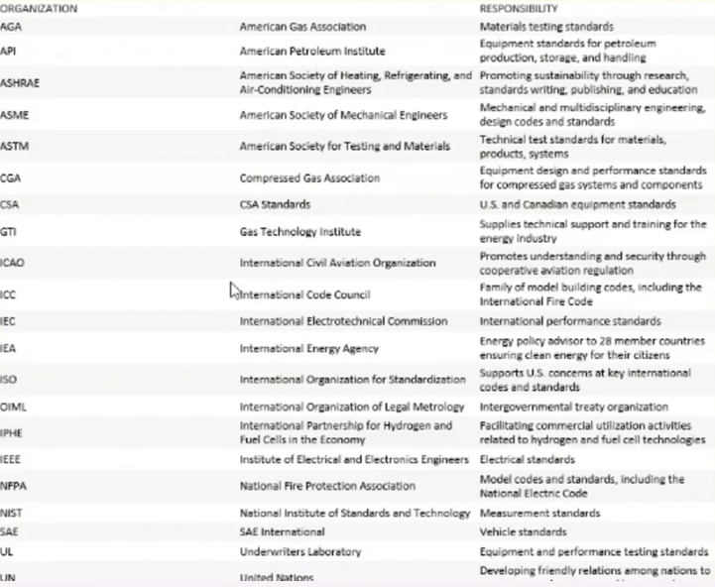
Codes and standards development organization and their roles

Slide 6
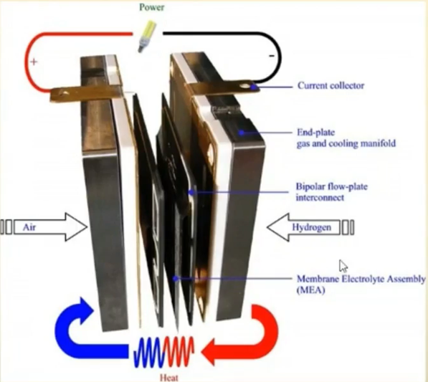

Slide 7
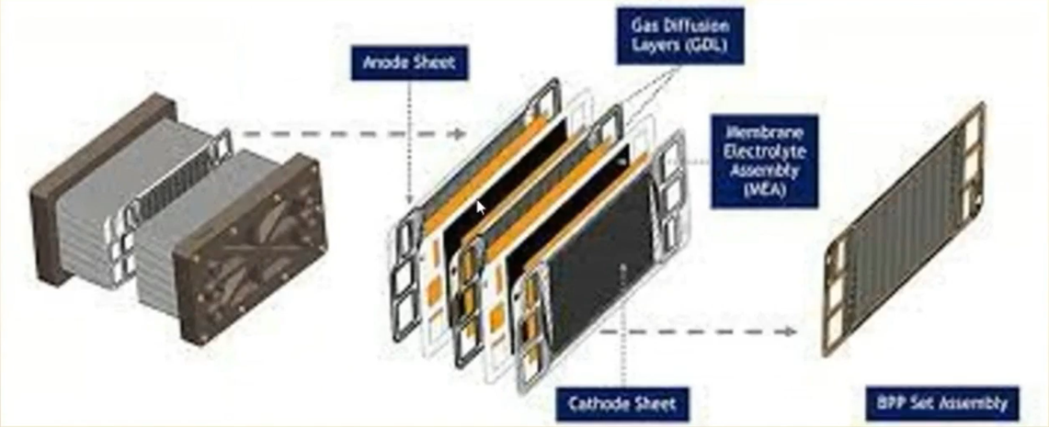

Slide 8
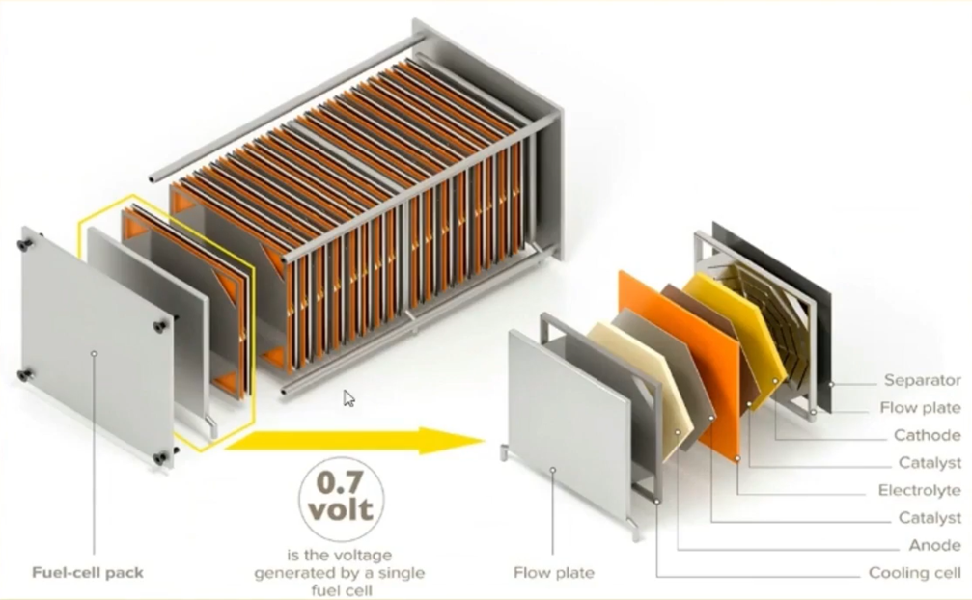

Slide 9
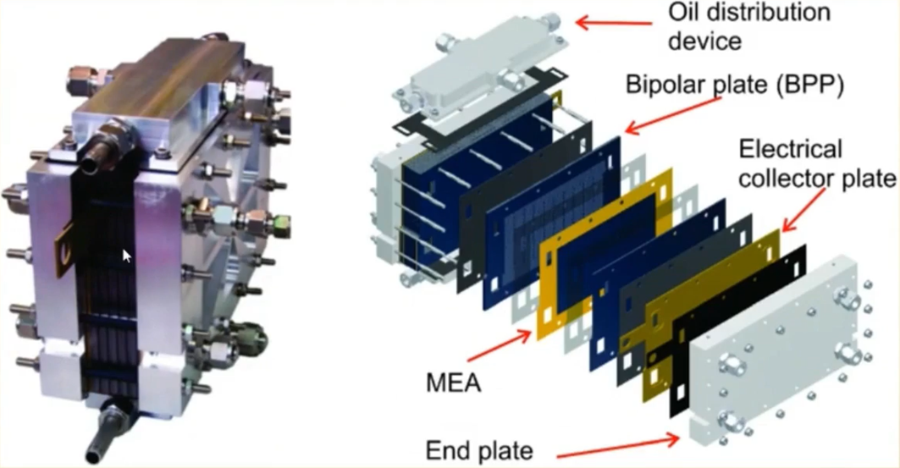

Slide 10
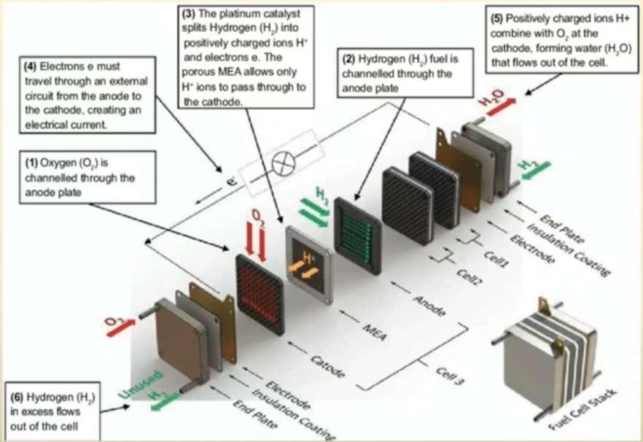

Slide 11
Clean mobility
• Clean mobility refers to development of zero emission vehicle technology for movement
of humans and goods
• According to European Commission, transport sector alone has a share of about 29%
of the total C02 emissions; However, road transport accounts for more than 70% of the emissions
• This can be achieved by using the following :
Electric Vehicles (EV)
Hydrogen based vehicle
Hybrid Vehicle
Vehicle using bio fuels
Improving IC engine technology

Slide 12
Thank you

